Slide 1
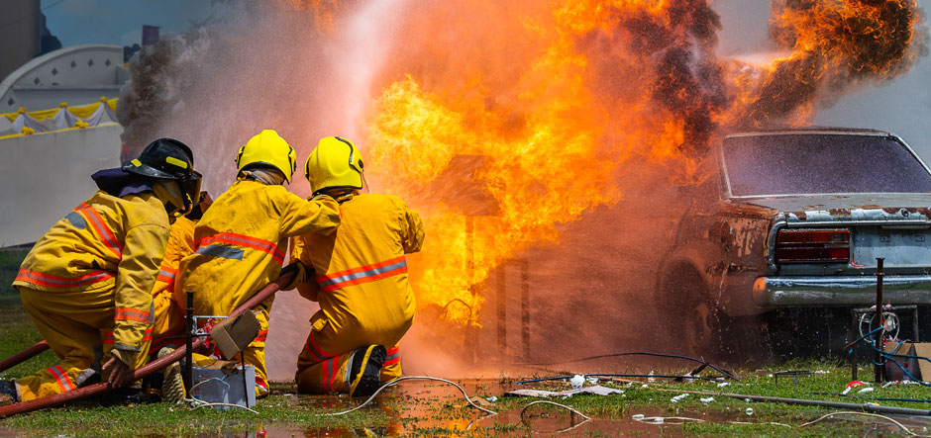
Team Patriots - Final
DAEN 690-001 (Fall 2020)

Slide 2

Team Patriots
George Mason University
Fairfax County Fire and Rescue Department/GMU Data Lab
DAEN 690-001 Capstone (Fall 2020)
Team Patriots

Slide 3

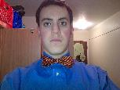


Team Patriots - Members
Shiva Ram Kaushil Pabba
SCRUM Master
Andrew Bloom
Product Owner
Jahnavi Jonnalagadda
Developer
Doddanaik Basavaraj Vakkund
Developer

Slide 4
Team Patriots - Context
Problem Context:
Domain of problem: Service operations to local communities
Importance of problem: As the majority of available first responders (especially fire, rescue, and emergency medical services (EMS)) do not have sufficient satisfactory data and analytical knowledge, their performance regarding life-and-death decisions could decline. It would also result in declining performance regarding how they respond to challenges they face in their daily line of work.
Why Data analysis?
To extract insights into fire problems.
To improve resource allocations to combat incidents.
To identify any training needs.

Slide 5
Team Patriots – Problem Statement
Problem Statement:
Find if there is a correlation between provider, shift, station, or battalion to EMS call outcome.
Examining the relationship of EMS procedures and medications to incident distance from the hospital for transported patients.
How frequently are units dispatched within X minutes of becoming available. X to be established, maybe 20-30 minutes.
How often are 2nd emergencies occurring within X minutes by incident type (EMS/Fire/PSERVF) by first due. X to be established, maybe 30 or 10.
Additional analysis requested by sponsors:
Standard deviation of EMS call outcome for each station across all shifts.
Standard deviation of EMS call outcome for each provider.

Slide 6
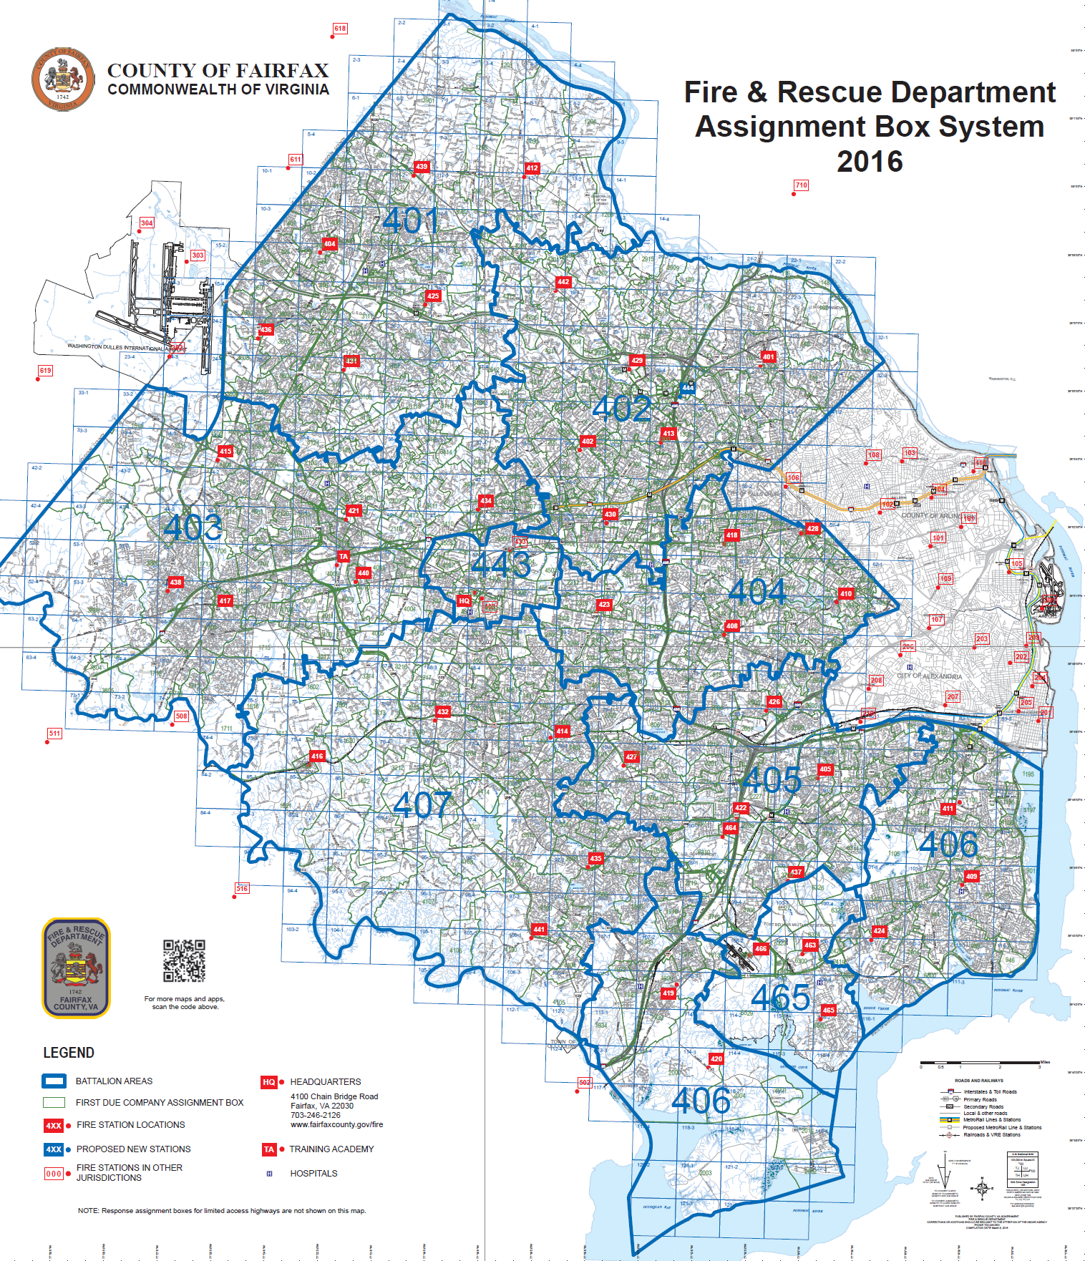
Fairfax county – Station and Battalion codes

Slide 7
Team Patriots – Datasets
Datasets description
Dataset Owner: Fairfax County Fire and Rescue Department (FCFRD)
Dataset Type: Proprietary
Dataset Size: 4 files; each file size ~ equals to 14 Mega Bytes
Datasets: 4 excel files;
A) EMS call outcome
B) Patient Distances
C) Incidents by due
D) Incidents by unit
Missing values are ignored since they constitutes approximately 0.001% in each dataset

Slide 8
Team Patriots – Algorithms/ Analytics used
Analytic/Algorithms used:
Linear regression,
Pearson’s correlation,
Carmer's V test
Statistical measures like mean, standard deviation, frequency
Computer Resources used: large CPU; laptop; etc.
Tools used:
Jupyter Notebook
Tableau Builder
Tableau Prep
MS Excel
R Studio
You Track

Slide 9
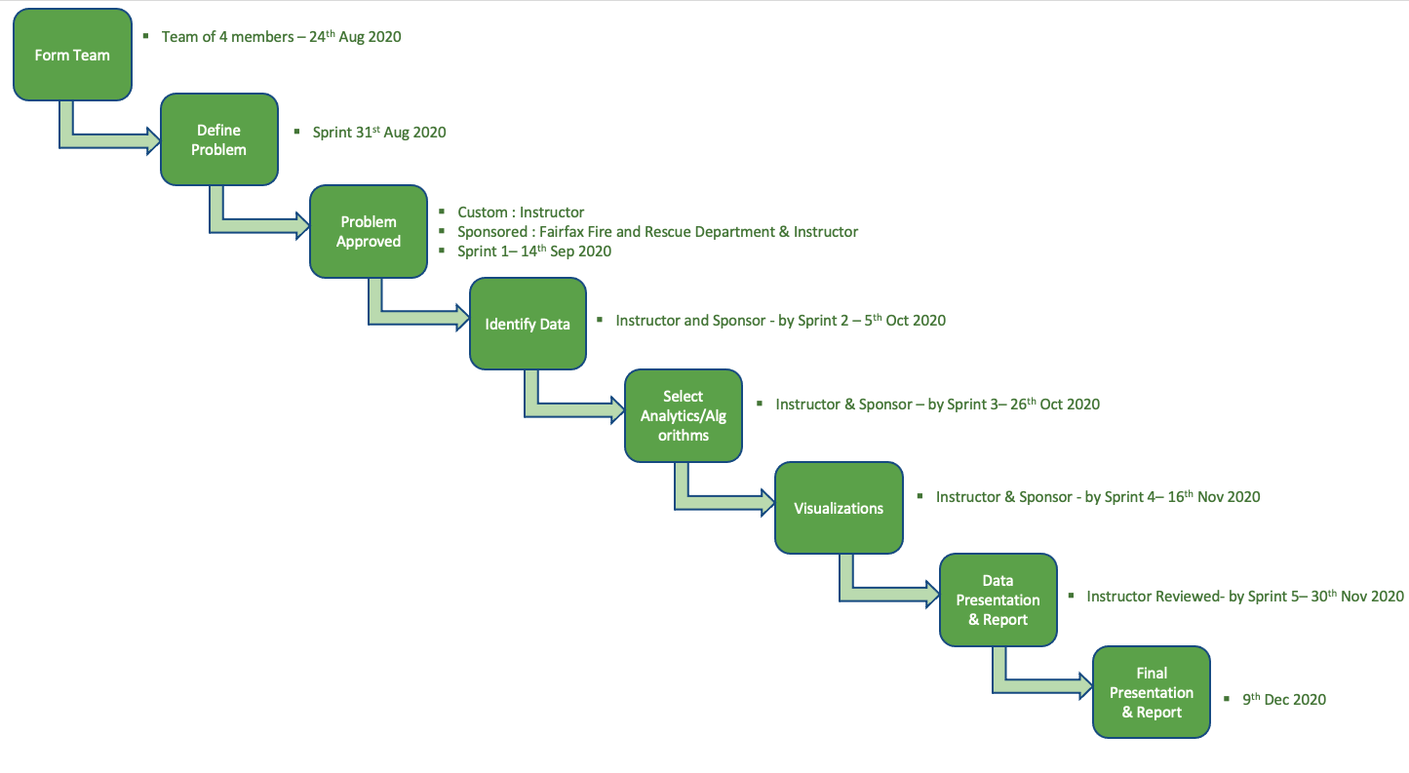
Workflow of Agile development

Slide 10
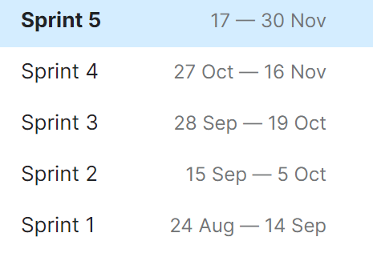
You Track
Sprint Schedule:
Final Presentation
Data Visualizations
Analytics and Algorithms
Dataset
Problem Statement

Slide 11
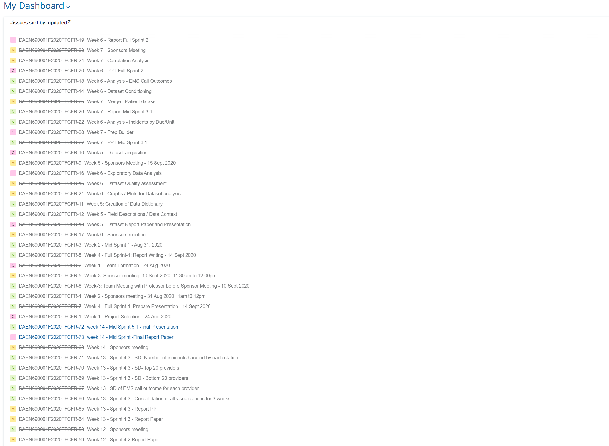
You Track – Agile Boards
Sprint 1 : 8 user stories cards, completed effort 71
Sprint 2 : 20 user stories cards, completed effort 116
Sprint 3 : 17 user stories cards, completed effort 137
Sprint 4 : 24 user stories cards, completed effort 142
Sprint 5 : 2 user stories Cards

Slide 12
(1) Finding correlation between provider, shift, station, or battalion to EMS call outcome.

Slide 13
Problem Statement 1- Understanding the data (EMS call outcome)
 | Attribute | Description | Example
1 | Patient_ID_Internal | Uniquely identifies each individual patient in database | 482724
2 | Performer_ID_Internal | Uniquely identifiers each of the individual healthcare providers in the database | 21D3C99E-9E01-E211-B5F5-78E7D18CFD3C
3 | Response_EMS_Shift | Explains the shift during which a particular EMS call occurred | B - Shift
4 | Response_EMS_Vehicle_Unit_Number | Explains the EMS vehicle unit number that responded to the EMS call | M414
5 | Station | Represents the station that the EMS vehicle unit which responded to an EMS call belongs to | 14
6 | Battalion | Represent the battalion that the EMS vehicle unit which responded to an EMS call belongs to | 407
7 | Disposition_Incident_Patient_Disposition | Provides the outcome of the EMS call, either for the patient or the incident | Treated & Transported

Slide 14
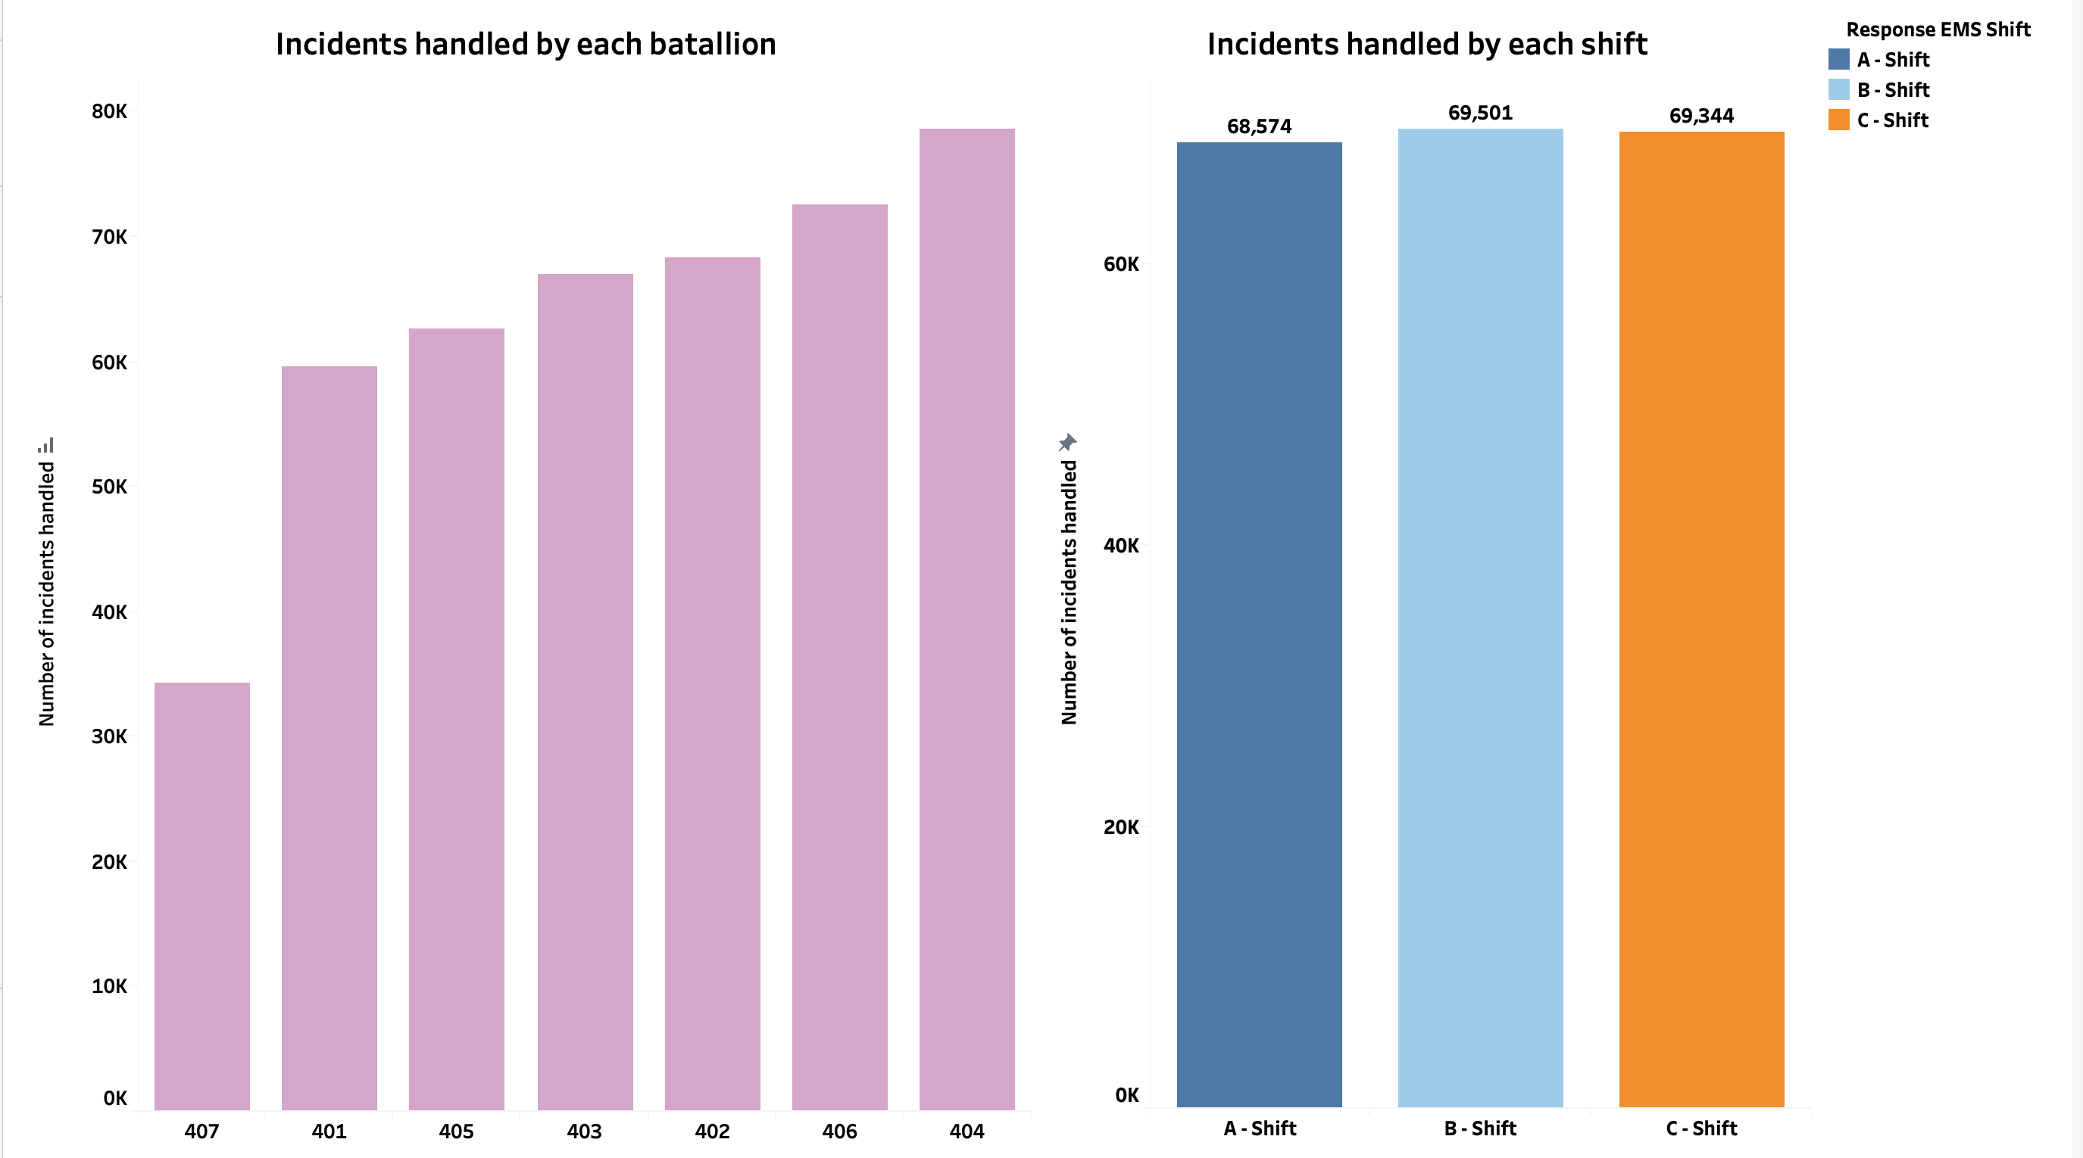
Problem Statement 1- Exploratory data analysis
Notes:
1) There is no variation in number of incidents handled by each shift. Distribution is uniform.

Slide 15
Problem Statement 1- Chisquare test for independence and Cramer's V for correlation
Chosen P value = 0.05 (95% confidence); Null hypothesis → Input and output variables are not dependent.
Cramer's V values close to → 0 no association, close to → 1 complete association.
P value less than 0.05→ reject null hypothesis and conclude that input and output variables are statistically dependent.
Cramer's V values are close to 0 → no correlation between input and output variables.
 | Output Variable –EMS call outcome
Input Variable | P-Value | Cramer's V
Shift | 0.00006 | 0.00
Provider | 0.0000052 | 0.01
Station | 0.0000076 | 0.00
Battalion | 0.000009 | 0.00

Slide 16
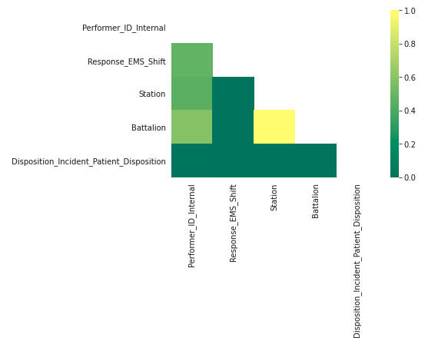
Problem Statement 1- Visualization- Correlation plot for Cramer's V results
Notes:
The results from the Crammer’s v test are visually displayed
We can see that all features with respect to each other have almost no correlation. Only battalion and station is seen to have positive and high correlation (equals to 1) because a station is inside battalion, and its value doesn’t change.

Slide 17
(2) Examining the relationship of EMS procedures and medications to incident distance from the hospital for transported patients.

Slide 18
Problem Statement 2 - Understanding the data (Patient Distances)
 | Attribute | Description | Example
1 | Patient_ID_Internal | Uniquely identifies each individual patient in database | 479853
2 | Incident_UnitLeftScene_To_PatientArrivedAtDestination_In_HHMMSS | Provides length of time, in HHMMSS format, between when the incident unit left the scene of the incident and when patient arrived at destination | 0:19:20
3 | Incident_Unit_Left_Scene_Date_Time | Displays date and time when the incident unit left the scene of the incident | 1/1/2018 12:19:00 AM
4 | Incident_Patient_Arrived_At_Destination_Date_Time | Displays date and time when patient arrived at destination | 1/1/2018 12:39:00 AM
5 | Feet | Gives distance between incident scene and hospital in terms of feet(ft) | 37484.09521
6 | Miles | Gives distance between incident scene and hospital in terms of miles (mi) | 7.099260456
7 | Medication_Given_RXCUI_Code | Provides corresponding numerical code for value of Medication_Given_Description field | 7806
8 | Medication_Given_Description | Describes type of medication that was given to patient | Oxygen
9 | Procedure_Performed_Code | Provides corresponding numerical code for value of Procedure_ Performed_Description field | 392230005
10 | Procedure_ Performed_Description | Describes type of medical procedure that occurred | IV Start - Extremity Vein (arm or leg)

Slide 19
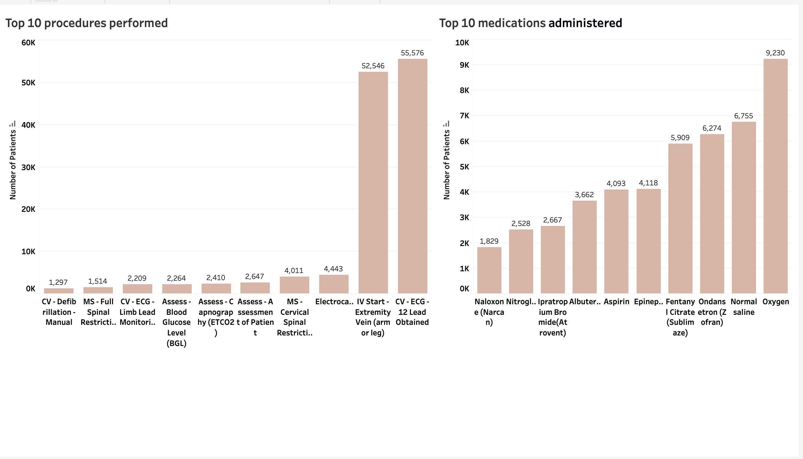
Problem Statement 2 - Exploratory data analysis
Notes:
32 medications total
Albuterol- shortness of breath
Aspirin- blood thinner, pain relief, fever, headaches

Slide 20
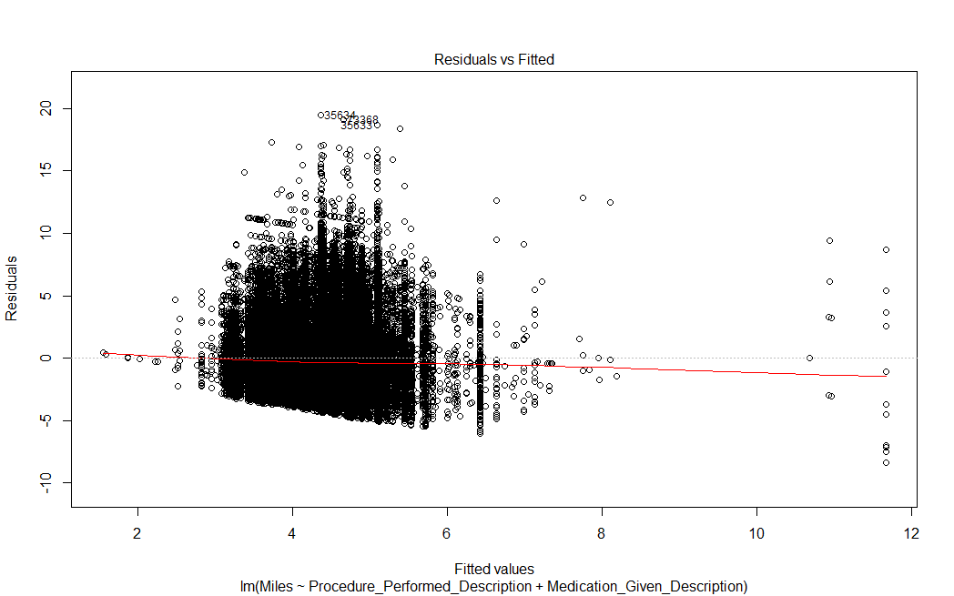
Problem Statement 2 - Visualizations
Notes:
For Residuals vs fitted graphs the red line is expected to be close to the horizontal line centered at 0 rather than, to show that there is no indication of non-constant variance.
For the above plot the red line must be a horizontal line but it is in the shape of parabola which shows that the assumption of linearity is violated.

Slide 21
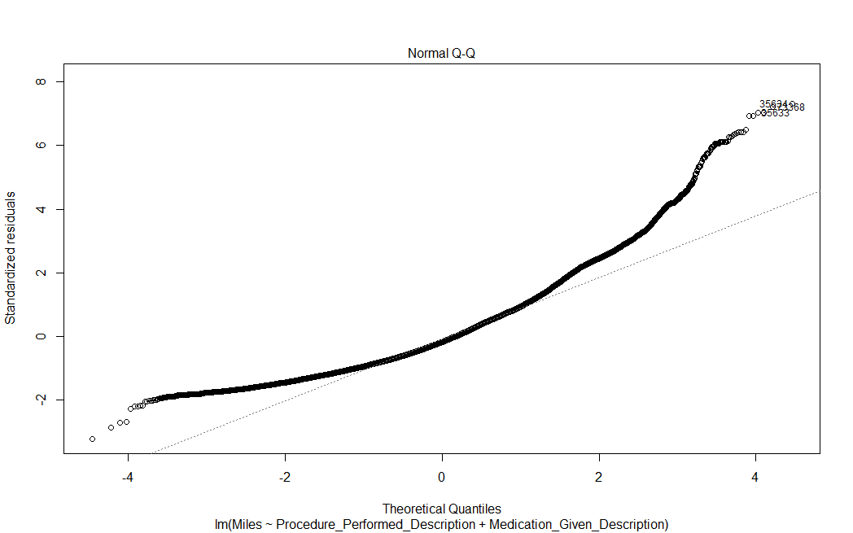
Problem Statement 2 - Visualizations
Notes:
In Q-Q plot the residuals must be perfectly aligned with the diagonal line to satisfy the assumption that the residuals are normally distributed. In the above plot the residuals are not perfectly aligned with the diagonal line. Only some part of residuals can be observed on diagonal line while a good number of residuals can be seen above diagonal line showing the upper and lower tails. We can assess the Normality of residuals assumption using the Q-Q plot which seems to be violated.

Slide 22
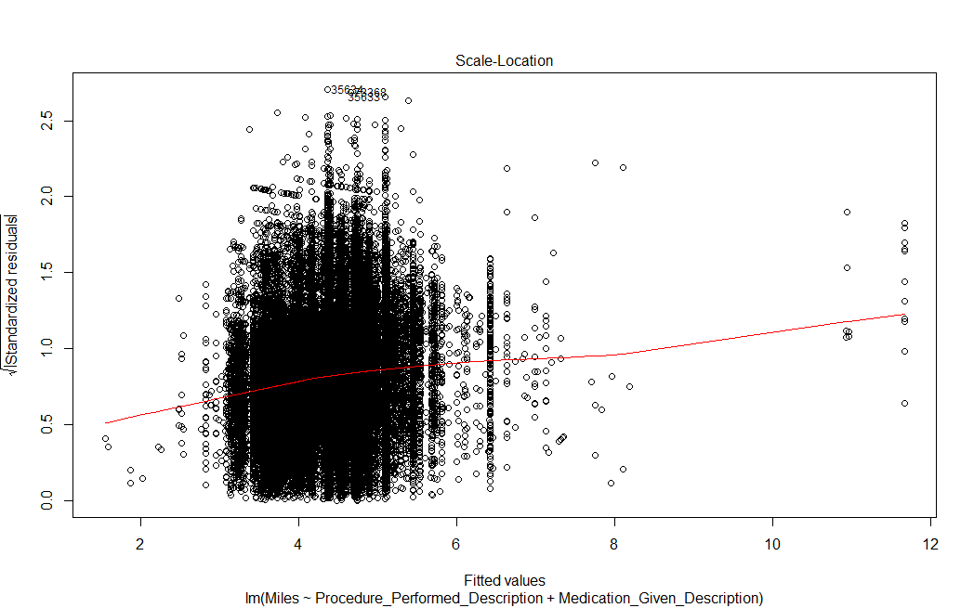
Problem Statement 2 - Visualizations
Notes:
In the Scale-Location plot a horizontal line with equally spread points is expected which indicates good Homoscedasticity. In the above plot a diagonal straight line can be observed which indicates the residuals are spread somewhat uniformly. The assumption of homoscedasticity of residuals that is homoscedasticity can be assessed using the scale-location plot.

Slide 23
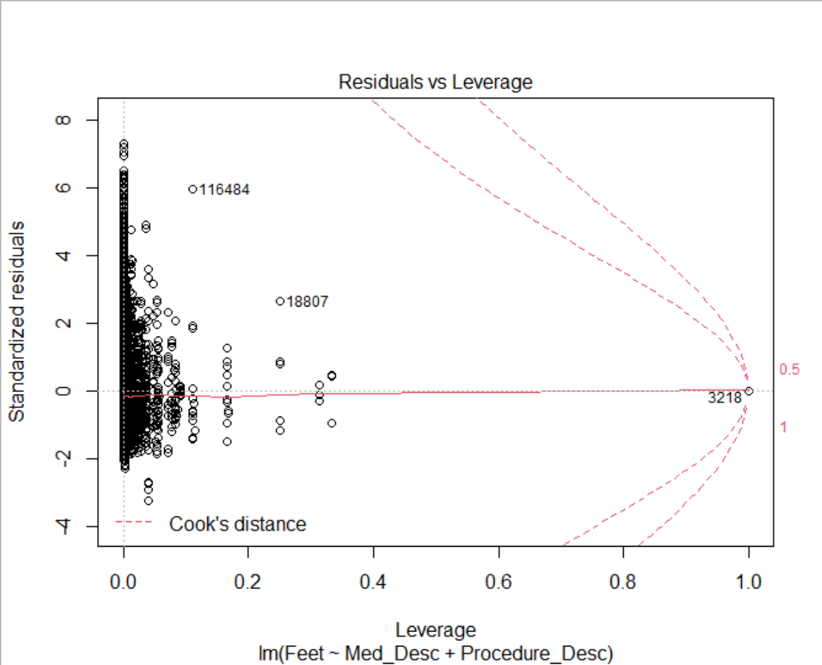
Problem Statement 2 - Visualizations
Notes:
In the Residuals Vs Leverage plot there should be no evidence of outliers. The dashed curves i.e. cook’s distance lines should not appear on the plot. None of the data points should come close to having both high residuals and leverage. In the above plot we can observe the cook’s distance lines with an influential observation as #3218. The assumption of independence of residual error terms can be assessed using the Residuals Vs Leverage plot.

Slide 24
Problem Statement 2 - Results
Linear regression models
Procedures performed → The wound -burn care procedure increases incident distance from the hospital relative to an EMS call involving an airway – clear/suction procedure (baseline) by 36544.857 feet
Medications administered → medication diazepam (valium) increases incident distance from the hospital relative to an EMS call involving aspirin (baseline) by 32419.578 feet

Slide 25
(3) How frequently are units dispatched within X minutes of becoming available. X to be established, in minutes.

Slide 26
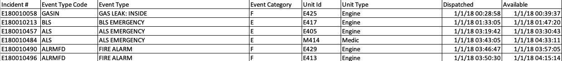


Problem Statement 3- Understanding the data (Incident by unit)
 | Attribute | Description | Example
1 | Incident # | Uniquely identifies each individual incident in database | E180010058
2 | Event Type Code | Provides a shorthand abbreviation of the Event Type in the following column | GASIN
3 | Event Type | Explains the type of event that occurred | GAS LEAK: INSIDE
4 | Event Category | Provides a letter for each type of event category that occurred: E for EMS, F for fire, and P for public service | F
5 | Unit ID | Explains the ID of the unit that was dispatched to the scene of the incident | E425
6 | Unit Type | Explains the type of unit that was dispatched to the scene of the incident | Engine
7 | Dispatched | The time that the unit was dispatched to the scene of the incident | 1/1/2018 12:28:58 AM
8 | Available | The time that the unit was available for next incident | 1/1/2018 12:39:37 AM

Slide 27
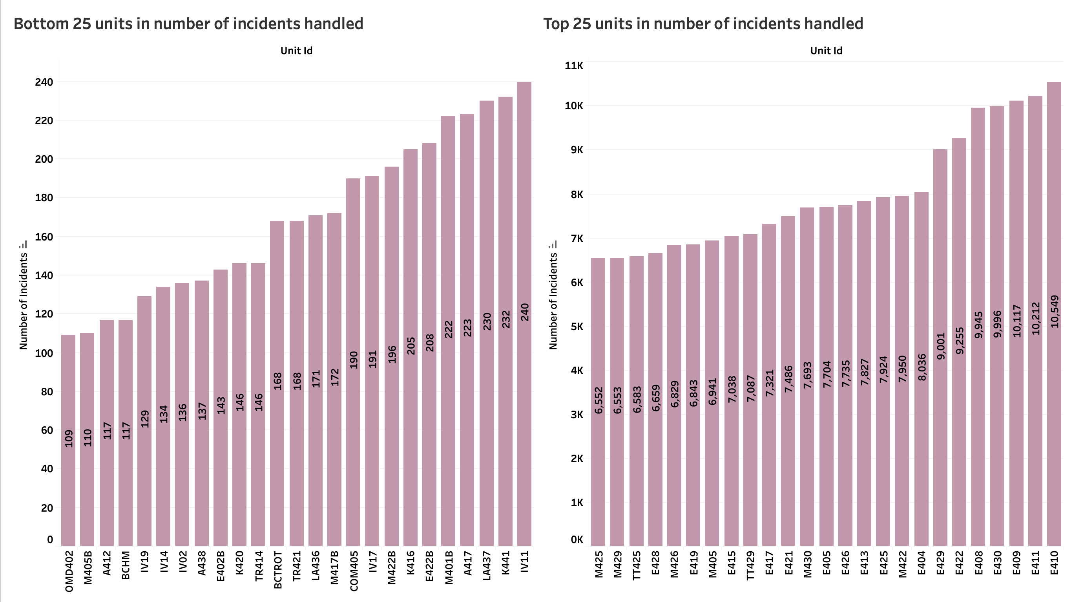
Problem Statement 3 - Exploratory data analysis
Notes:
5 event categories, majority of incidents handled are of type emergency followed by fire and public service. Test and misc event categories are not actual events.

Slide 28
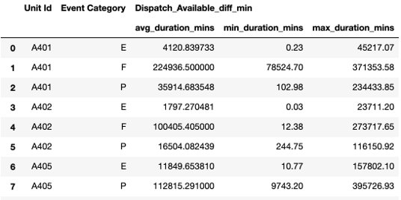
Problem Statement 3 - Analytics and Results
Steps performed to solve the problem:
Sort data by unit id, event category, and dispatch time
Finding difference between available time and next dispatch time in minutes
Keeping only the min values of the difference for each day
Finding the frequency of units dispatched after becoming available for each event category by taking the average of the min frequency
Results:

Slide 29
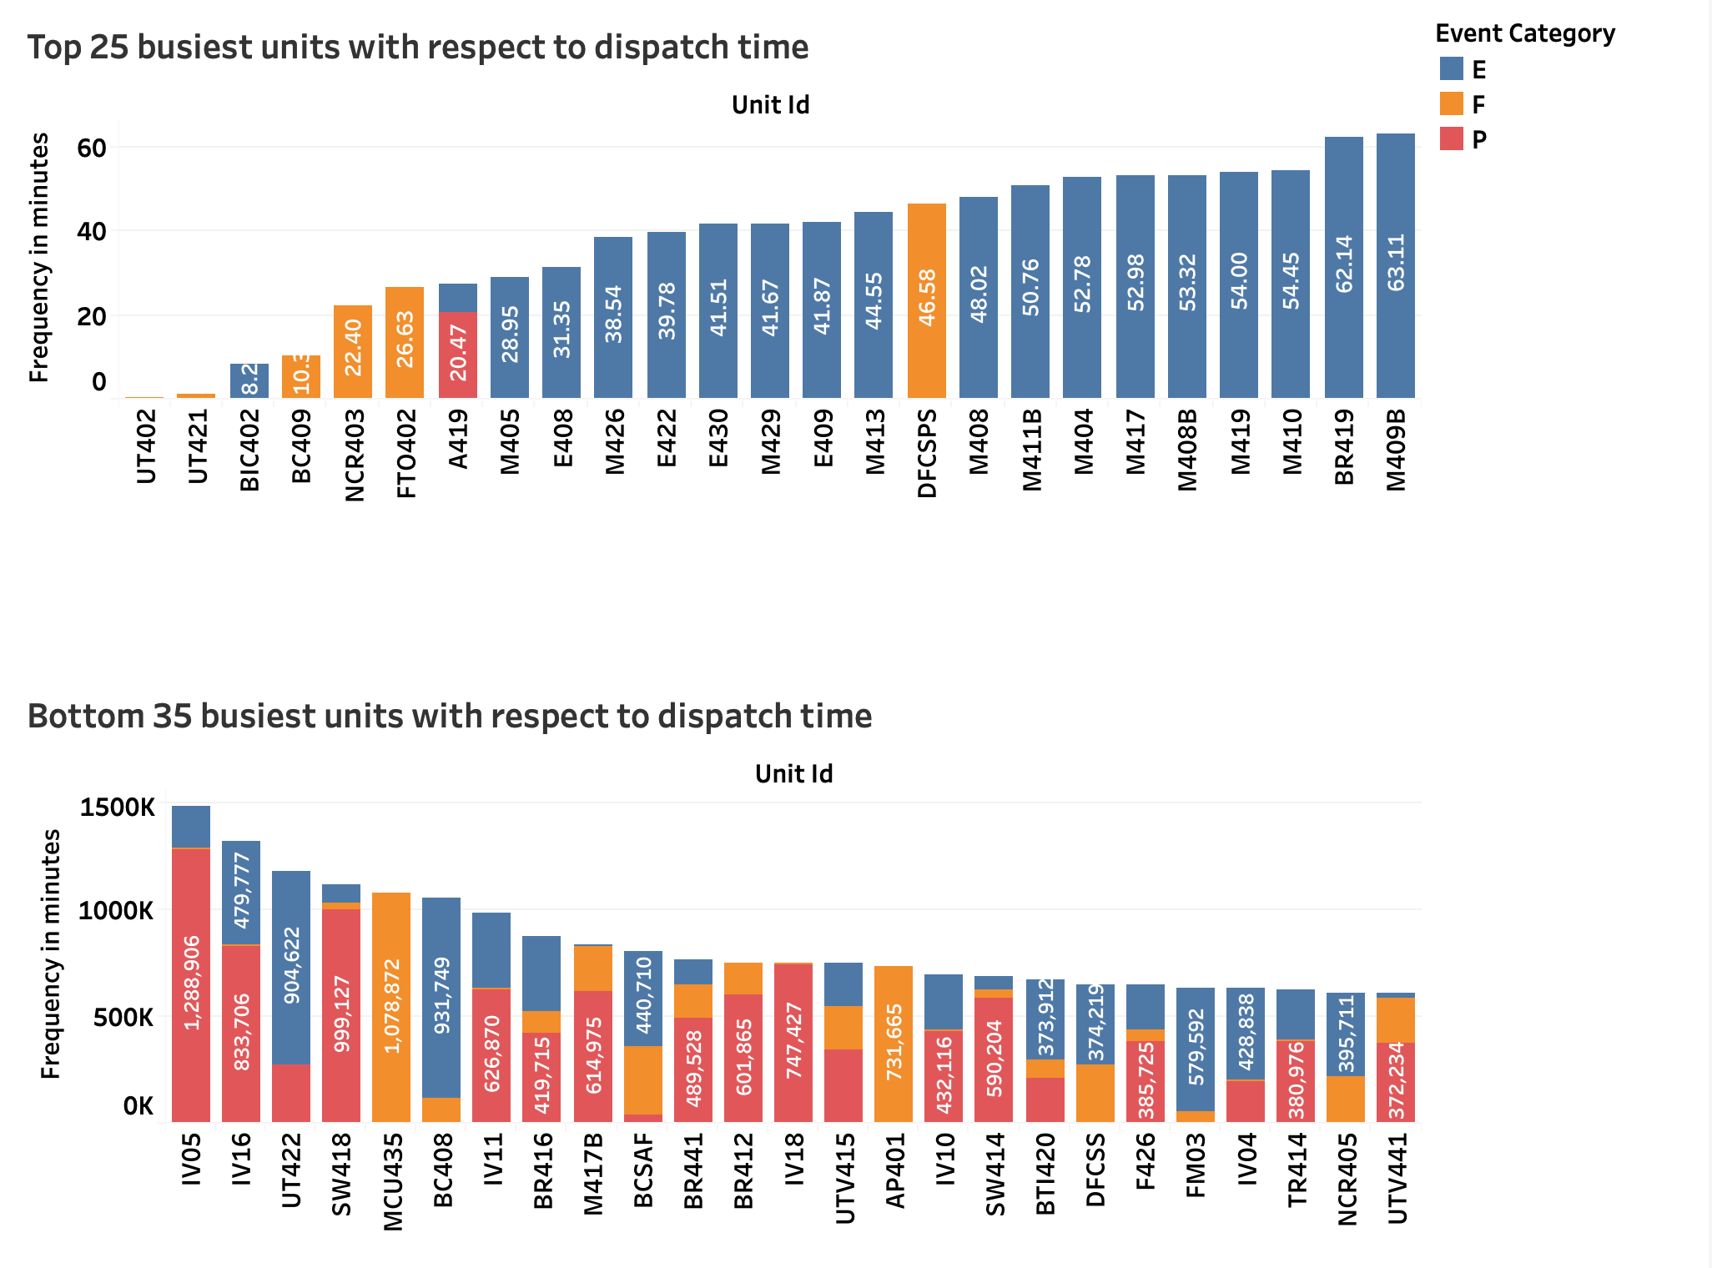
Problem Statement 3 - Visualization
Notes:
322 units,
UT402, UT 421, BIC 402 are the busiest units while IV16, IV05 are the slowest units with the frequency greater than 900 days (~ 1,300,000 minutes).

Slide 30
(4) How often are second emergencies occurring within X minutes by incident type (EMS/Fire/PSERVF) by first due. X to be established in minutes.

Slide 31
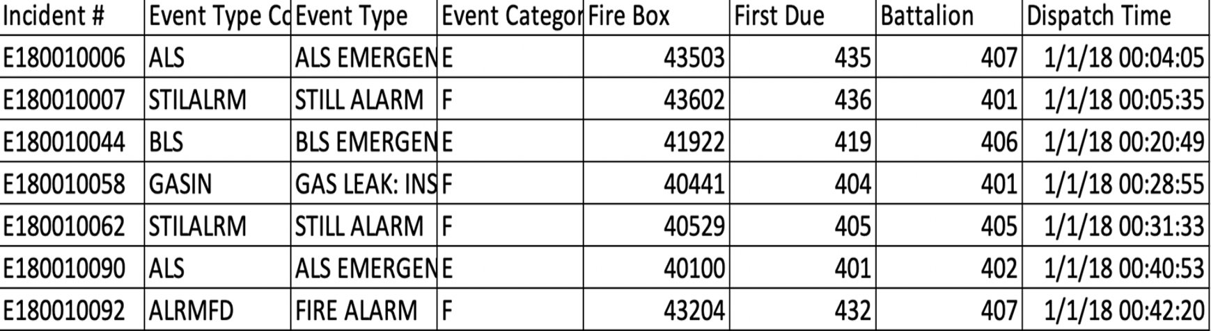

Problem Statement 4- Understanding the data (Incident by first due)
 | Attribute | Description | Example
1 | Incident # | Uniquely identifies each individual incident in database | E180010058
2 | Event Type Code | Provides a shorthand abbreviation of the Event Type in the following column | GASIN
3 | Event Type | Explains the type of event that occurred | GAS LEAK: INSIDE
4 | Event Category | Provides a letter for each type of event category that occurred: E for EMS, F for fire, and P for public service | F
5 | First Box | Contains a numbered ID for the fire box that contains the device for notifying the respective fire station of a fire outbreak | 43503
6 | First Due | Refers to either the first apparatus arriving on the scene of a fire or the area in which a company is expected to be the first to arrive on the scene | 435
7 | Battalion | Represents the fire battalion that responded to the incident | 407
8 | Dispatch time | Displays the time that the unit was dispatched to the scene of the incident | 1/1/2018 12:04:00 AM
Notes:
Difference of dispatch time between two consecutive rows

Slide 32
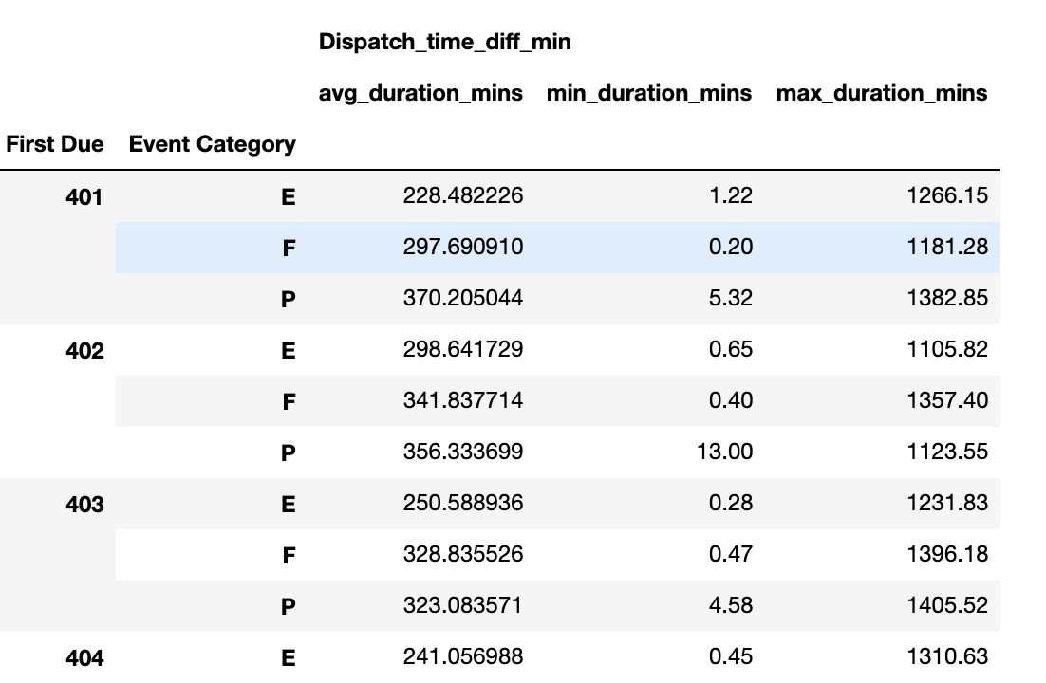
Problem Statement 4 - Analytics and Results
Steps performed to solve the problem:
Grouped data into event categories (E/F/P)
Sort data by first due and dispatch time
Finding difference between two consecutive rows
Keeping only time taken for second emergency and discarding other data
Finding average time taken for second emergency by incident type and by first due.
Results:

Slide 33
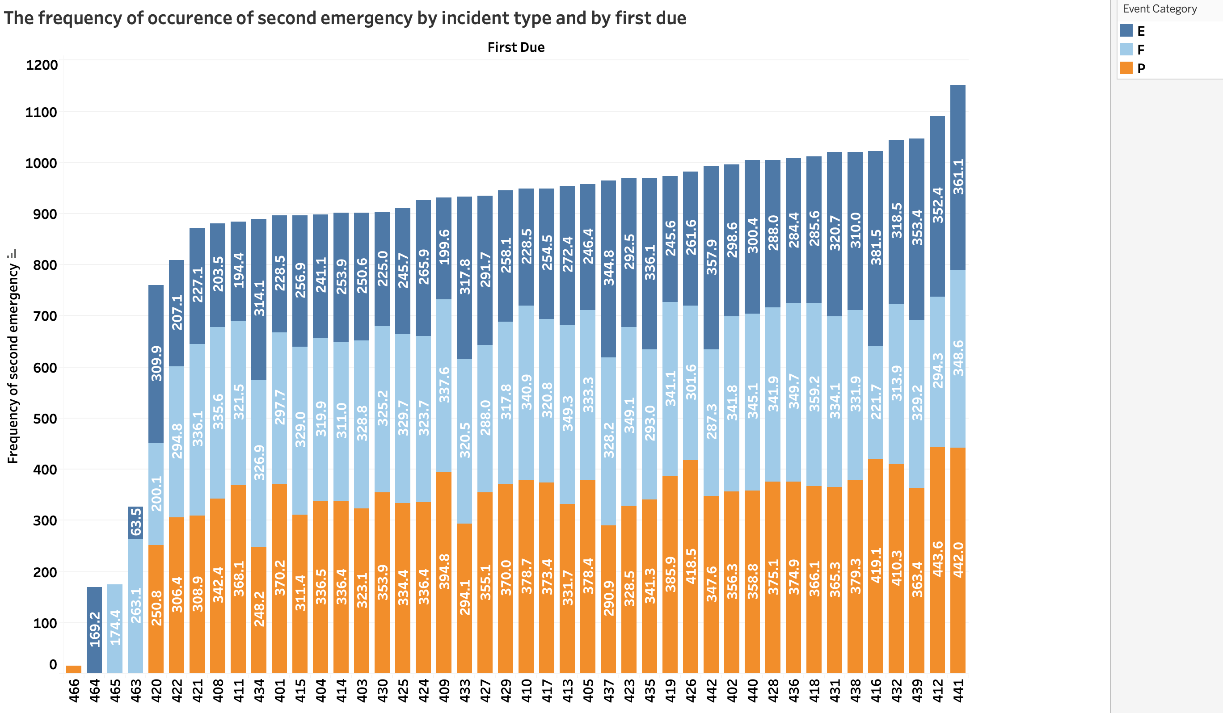
Problem Statement 4 - Visualization
Notes:
Stations 420, 421, 422 are the busiest stations when compared with slow stations like 439,412 and 441

Slide 34
(Additional analysis) Standard deviation in EMS call outcome for each station and each provider

Slide 35
Additional analysis – Analytics and Results
Standard deviation in EMS call outcome for each Station
Group data by station, shift and ems call outcome
Find the total number of incidents handled, mean and standard deviation for each station using Python NumPy functions like mean, standard deviation and sum.
Standard deviation in EMS call outcome for each provider
Excluded providers who handled less than 100 incidents
Group data by performer and ems call outcome
Find the total number of incidents handled, mean and standard deviation for each station using Python NumPy functions like mean, standard deviation and sum.
Notes:
38 stations and 1522 providers.
831 providers handled more than 100 incidents. Only included these in analysis.

Slide 36
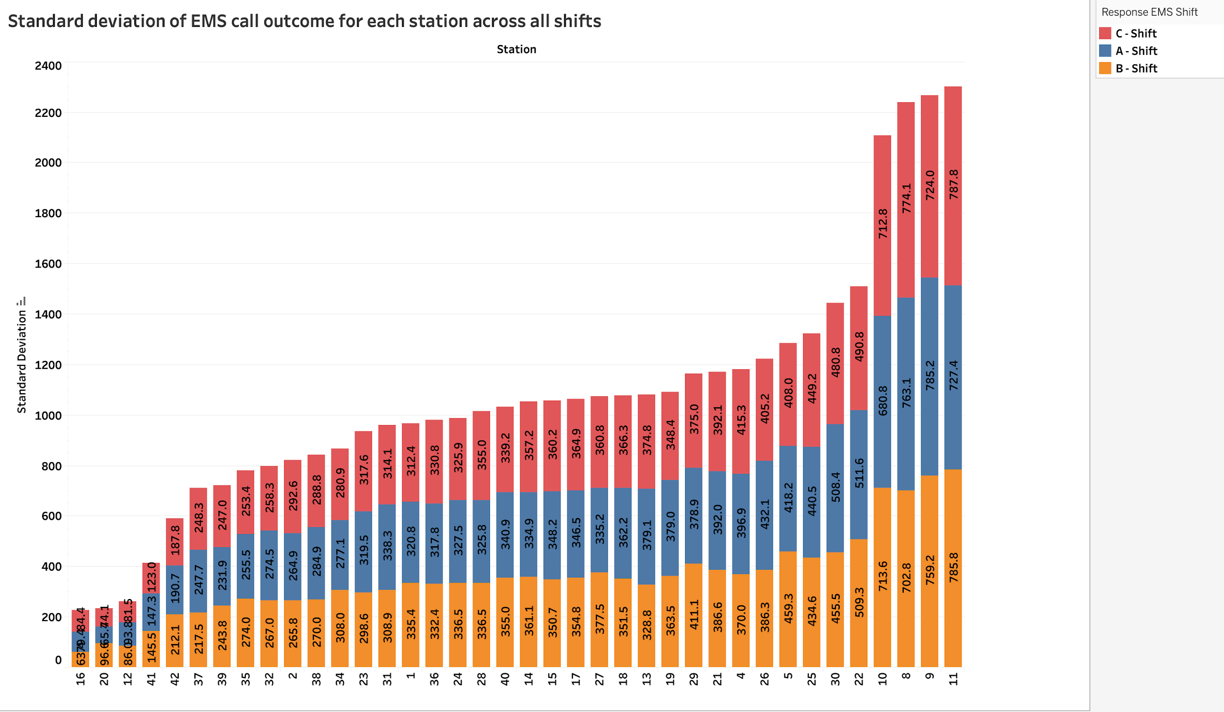
Additional analysis –Visualizations
Notes:
SD for stations 8,9,10,11 is high because these are the stations that handled highest number of incidents and when closely observed standard deviation across shifts are close to each other

Slide 37
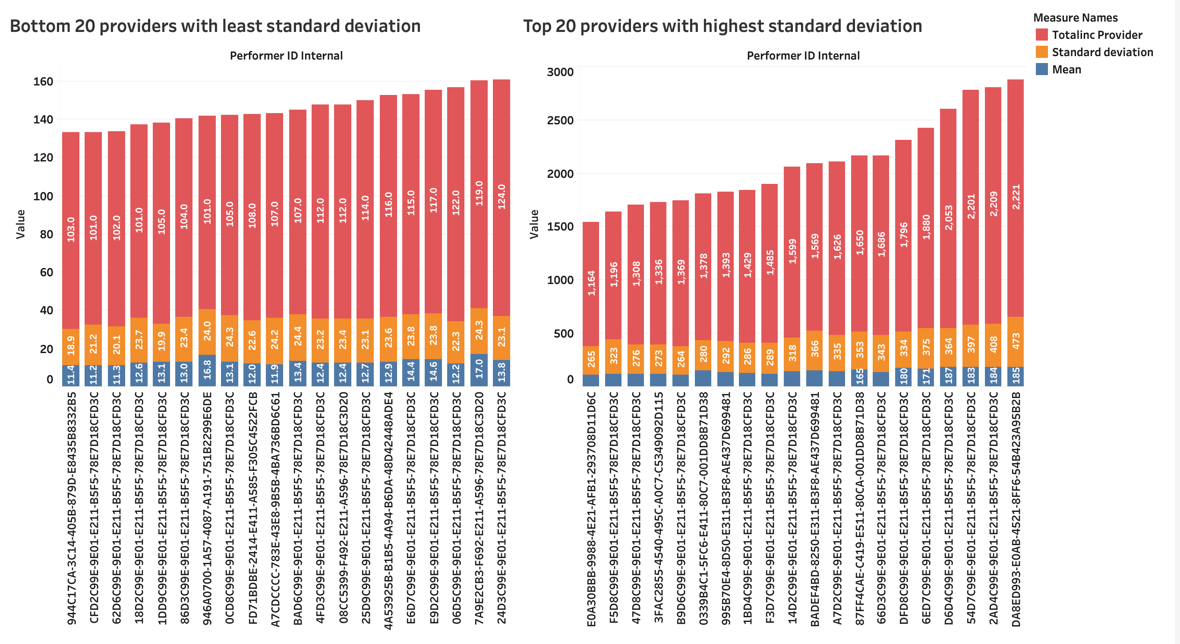
Additional analysis –Visualizations

Slide 38
Conclusions and Future Directions
Conclusions
Provider, shift, station, and battalion have no correlation with EMS call outcome
Diazepam (valium) medication contributes the most to incident distance from hospital relative to aspirin (baseline), and wound-burn care procedure contributes the most to incident distance from hospital relative to an airway – clear/suction procedure (baseline)
Frequency of units dispatched: UT402, UT 421, BIC 402 → busiest & IV16, IV05 → slowest > than 900 days (~ 1,300,000 minutes)
Second emergencies : 420,421, and 422 → busiest and 412, 439, and 441→ slowest stations
Future directions
Based on Automatic Vehicle Location (AVL) vs Mobile Computer Terminal data, i.e., how accurate are our personnel provided timestamps? Should AVL ping rates be shortened? Are our members clicking enroute significantly before the vehicle moves?
Notes:
Another potential future work is to see if including an additional unit in the battalion can reduce the response time of handling an incident

Slide 39
Thank You & Questions?

